Slide 1
WiFi Introduction
2022/07/14

Slide 2
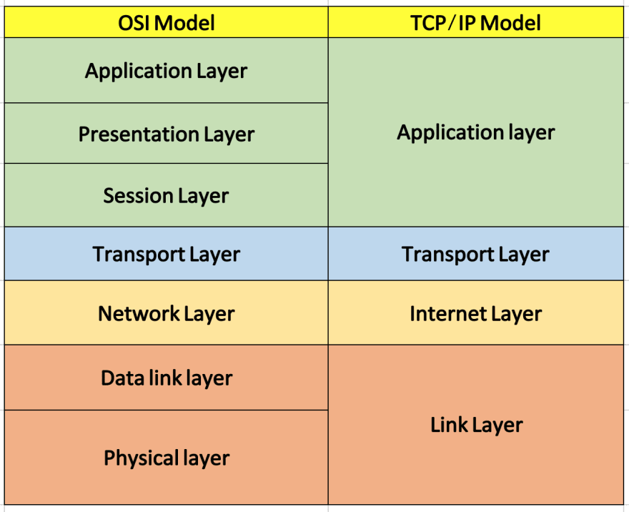
OSI Model Layers
MAC
PHY

Slide 3
802.11 Standards
802.11
802.11a
802.11b
802.11g
802.11n
802.11ac
802.11ax
802.11be
...

Slide 4
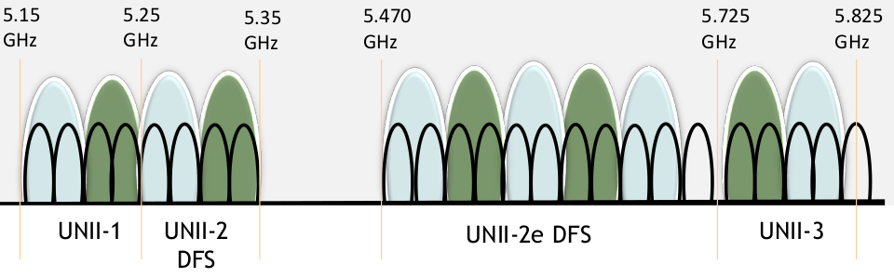
802.11a
max 54Mbps
OFDM
6, 9, 12, 18, 24, 36, 48 & 54M
works @ 5G band

Slide 5
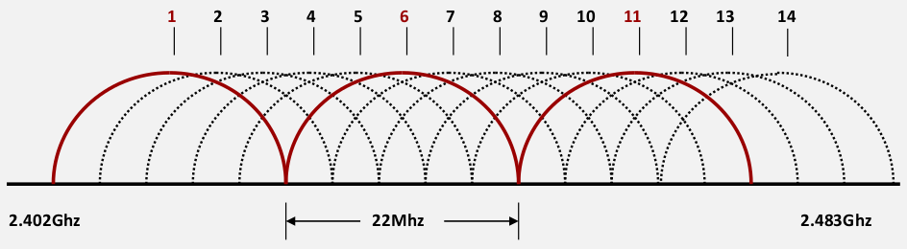
802.11b
max 11Mbps
DSSS
1, 2, 5.5, 11Mbps Rate
works @ 2.4G

Slide 6
802.11g
54Mbps
OFDM
6, 9, 12, 18, 24, 36, 48 & 54M
compatible with 802.11b

Slide 7
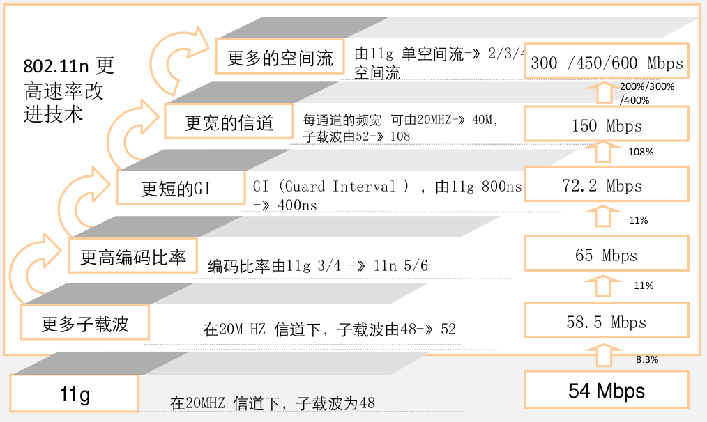
802.11n
max 600Mbps
2.4G and 5G band
OFDM
Features:
More subcarriers
Coding Rate
Short GI
40M bandwidth
MIMO (with 4 SS) and beamforming
AMSDU and AMPDU
BlockACK

Slide 8
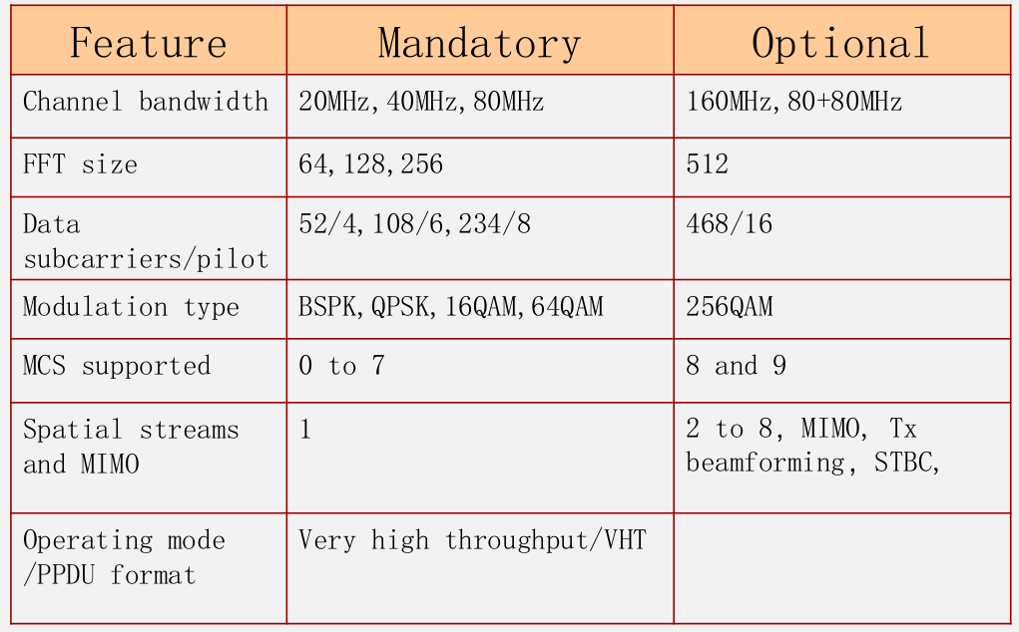
802.11ac
works @ 5G band
160M bandwidth
MIMO * 8
256 QAM

Slide 9
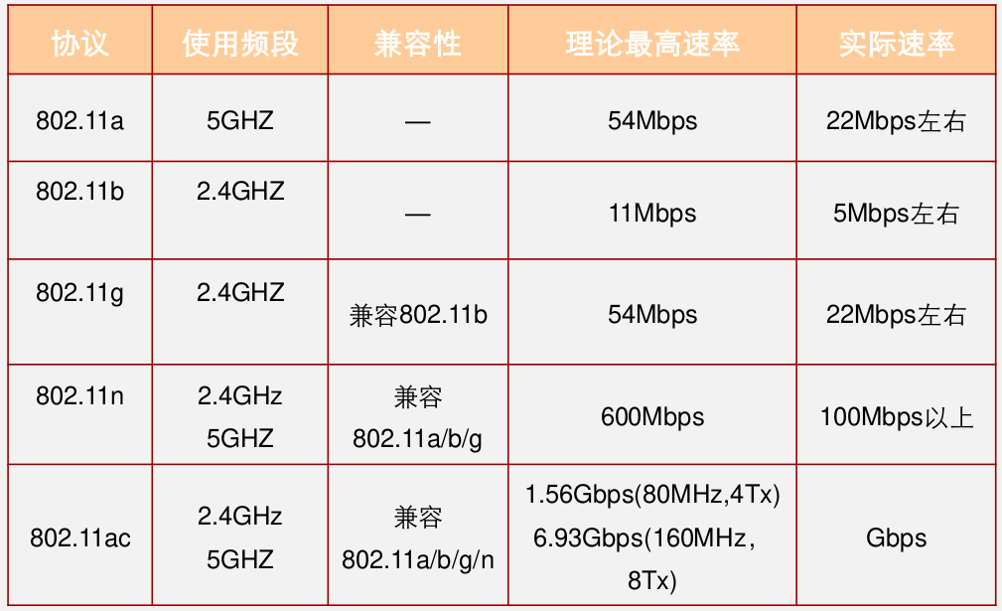
802.11a/b/g/n/ac

Slide 10
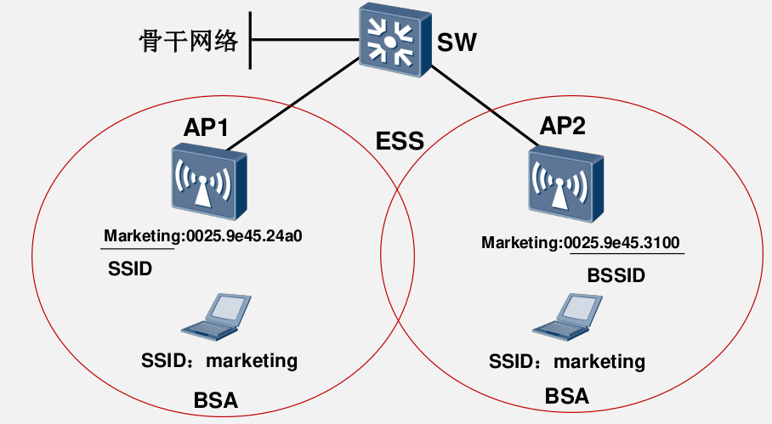
802.11 Basics
SSID: Service Set Identifier
BSSID: Basic Service Set Identifier
BSA: Basic Service Area
ESS: Extended Service Set

Slide 11
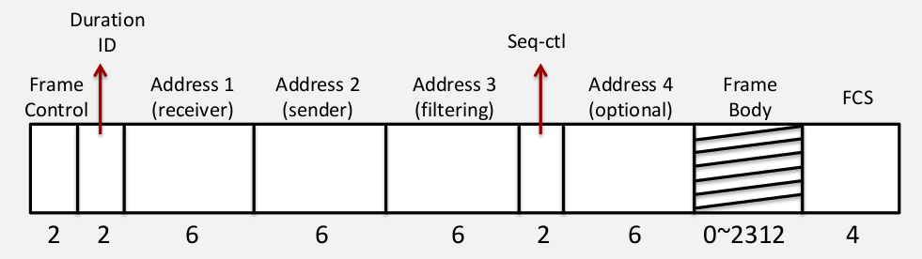
802.11 Frame

Slide 12
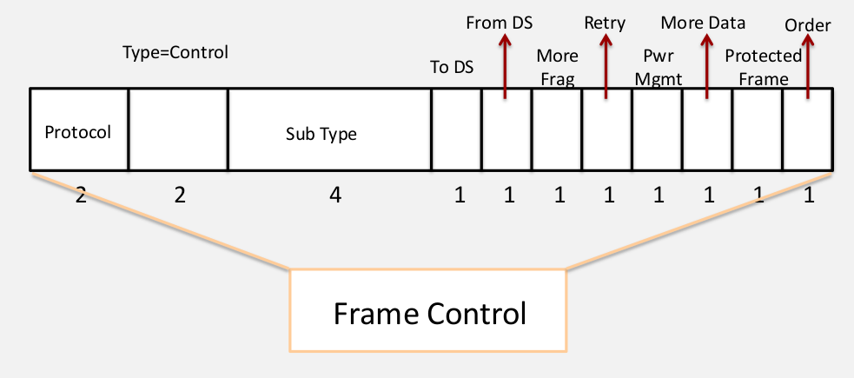
802.11 Frame - Frame Control

Slide 13
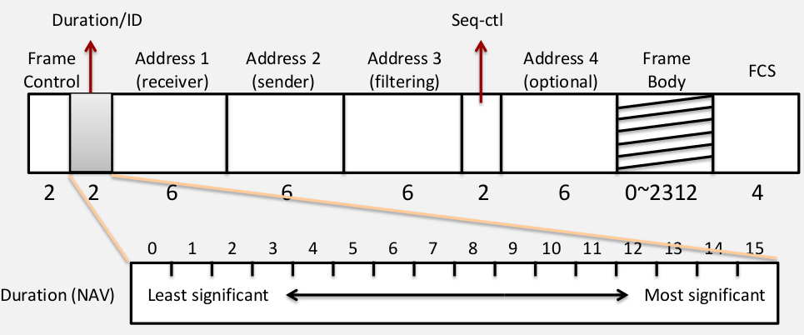
802.11 Frame - Duration/ID

Slide 14
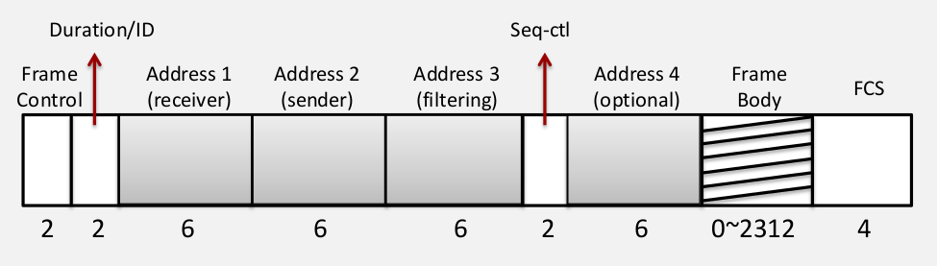
802.11 Frame - Addresses
Indicate the BSSID, SA, DA, TA (Transmitter address), RA (Receiver address), each of 48-bit address.

Slide 15
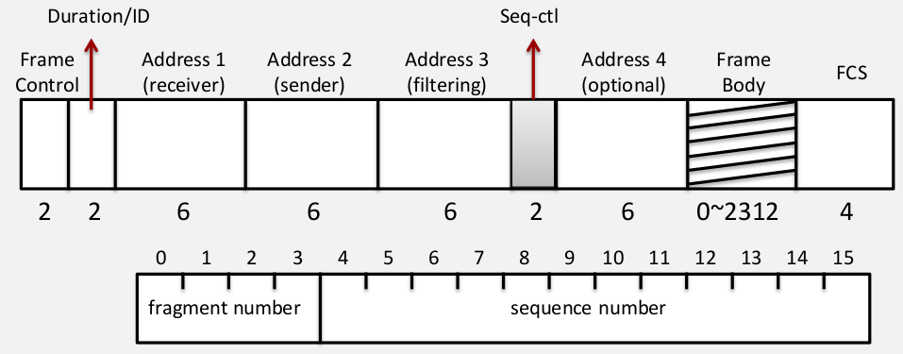
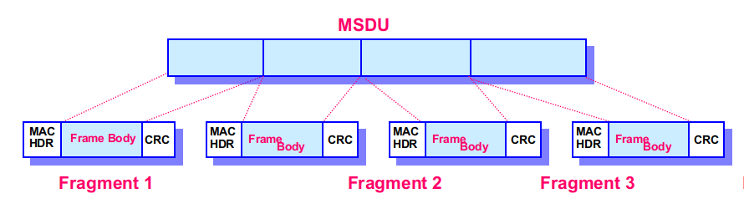
802.11 Frame - Seq control
Sequence Number (12-bit): An incrementing value. The same value shall be used for all fragments of the same MSDU.
Fragment Number (4-bit): Indicates the number of each individual fragment.

Slide 16
802.11 Frame Types
Data Frame
Control Frame
RTS, CTS, PS-POLL, BAR, BA, Trigger Frame, etc.
Mgmt Frame
beacon
assoc/auth/deauth/action, etc.

Slide 17
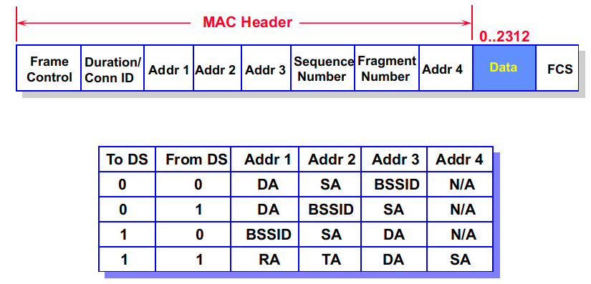
Data Frames

Slide 18
Frame exchange sequences
The following frame sequences are possible:
Data
Data - ACK
RTS - CTS - Data - ACK
Data - ACK - Data - ACK (Fragmented MSDU)
RTS - CTS - Data - ACK - Data - ACK (Fragmented MSDU)
...

Slide 19
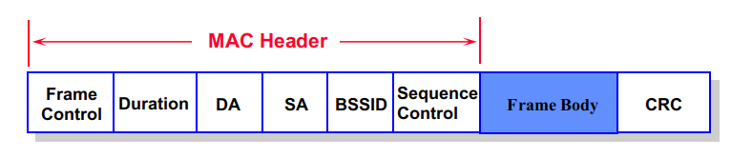
Management Frames
Management Frames
The BSSID
The AP address, if the station is an AP or associated with an AP.
The BSS ID of the ad hoc LAN, if the station is a member of an ad hoc LAN.
The Frame body shall be the information elements:

Slide 20
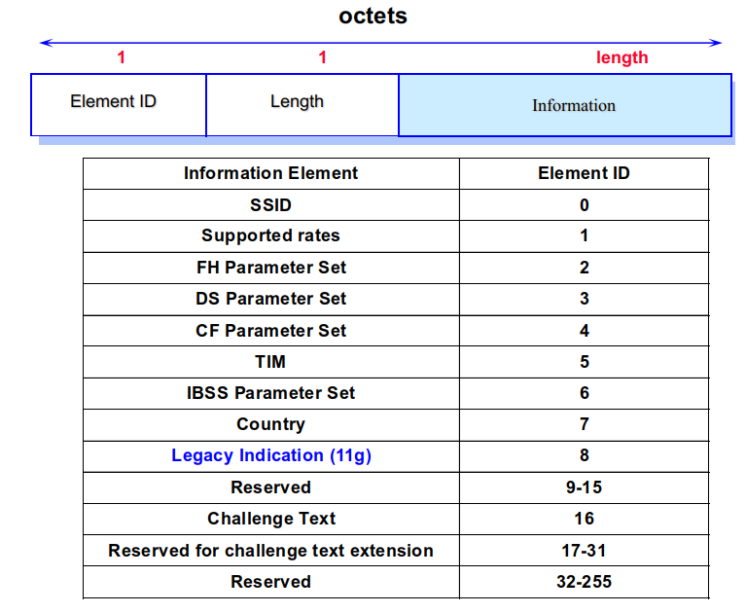
Management Frames - Information Element

Slide 21
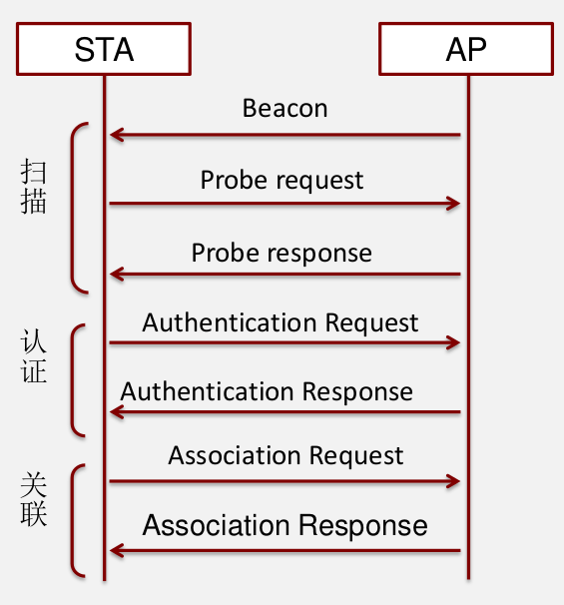
How to connect to AP
Scan
Authentication and PMK Caching
Association or FILS Assoc
DHCP/DHCPv6, etc.

Slide 22
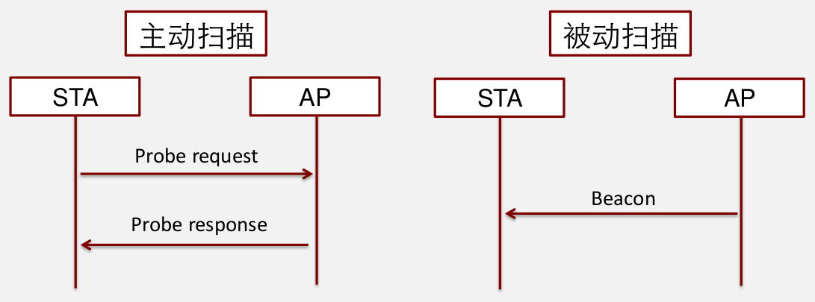
Scan
Active Scan
Passive Scan

Slide 23
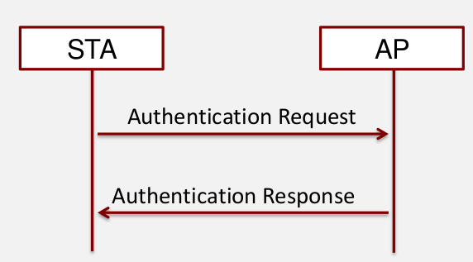
Authentication
Shared Key
Open System
SAE
802.1X

Slide 24
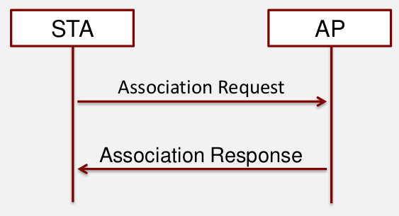
Association
Negotiate MAC/PHY capabilities
ciphers: TKIP, CCMP, GCMP, etc.

Slide 25
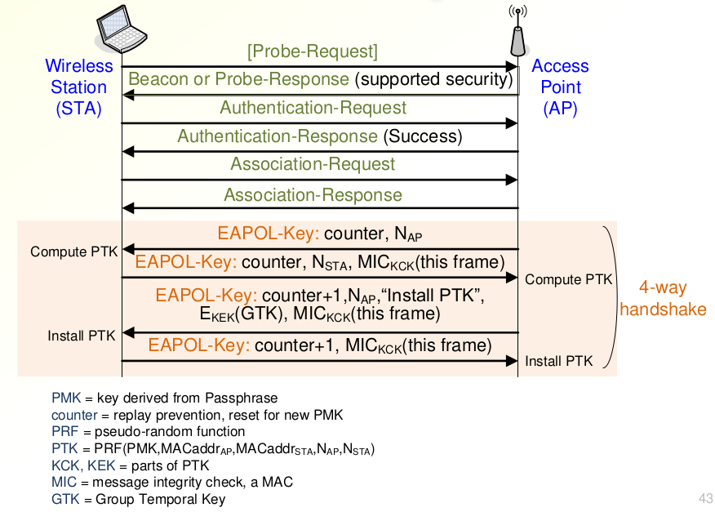
WPA/WPA2/WPA3 4-way handshake

Slide 26
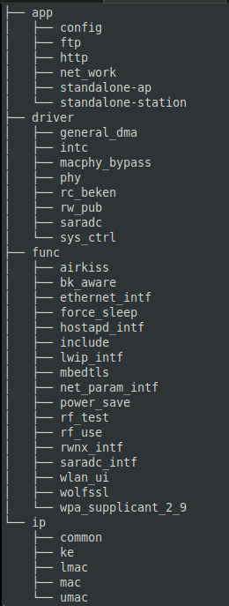
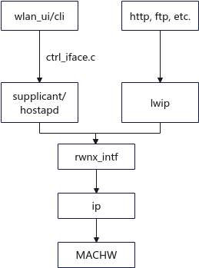
WiFi SDK 3.0.X structure
ip: 802.11 stack
wpa_supplicant: mlme, sme
rwnx_intf: data path and mgmt path
lwip: tcp/ip protocol stack
wlan_ui/wlan_cli: WiFi API
wolfssl/mbedtls: 3rdparty crypto routine for SHA-1, SHA-256, DH, ECC, etc.
How to review code?
WIFI API -> MGMT -> macsw
LWIP API -> DATA -> macsw

Slide 27
Basic WiFi API
bk_wlan_start: start STA/softAP
bk_wlan_start_p2p: start P2P
bk_wlan_stop: stop STA/softAP
bk_wlan_start_scan: scan AP
bk_wlan_start_monitor: monitor mode
bk_wlan_stop_monitor: stop monitor mode
sta_ip_start: assign static IP or start DHCPC

Slide 28
How to capture WiFi packets
Omnipeak for Windows
Wireshark for MacOS
set adapter mode to radiotap
Wireshark for Linux
set adapter to monitor mode, for example
ifconfig wlan0 down
iw wlan0 set mode monitor
ifconfig wlan0 up

Slide 29
Task to Do
wpa_supplicant / hostapd new features
DPP
802.11k
802.11v
WPA3
...
macsw
data path
mgmt path
stability
perfomance

Slide 30
Books recommended
802.11: The definitive Guide 中文版 《802.11权威指南》
802.11n: The survival Guide
802.11ac: The survival Guide
CWNA
Wi-Fi 6 for dummies
Wi-Fi 6 Protocol And Network
Advanced:
Next Generation Wireless LANs 802.11ac
802.11 Spec.
Others:
Matlab 802.11 Toolbox for PHY study
Linux mac80211

Slide 31
Next Lecture
802.11 In Details (in 3-4months)
wpa_supplicant/hostapd
802.11 PHY
802.11 MAC Layer
802.11 Security

